Slide 1
Introduction to
LibreOffice Development
LibreOffice automation via Scripting
Rafael Henrique Palma Lima

Slide 2
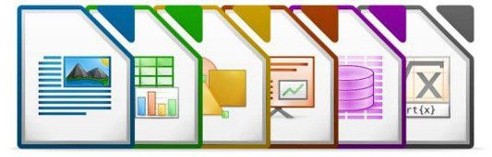

Why Scripting?
Automate common and repetitive tasks
Extend application functionalities
Interact directly with the API
Create custom applications tailored for your needs (integrate databases, create dialogs, forms, etc)
Supported Scripting Languages in LibreOffice
Basic
Python
JavaScript
BeanShell

Slide 3

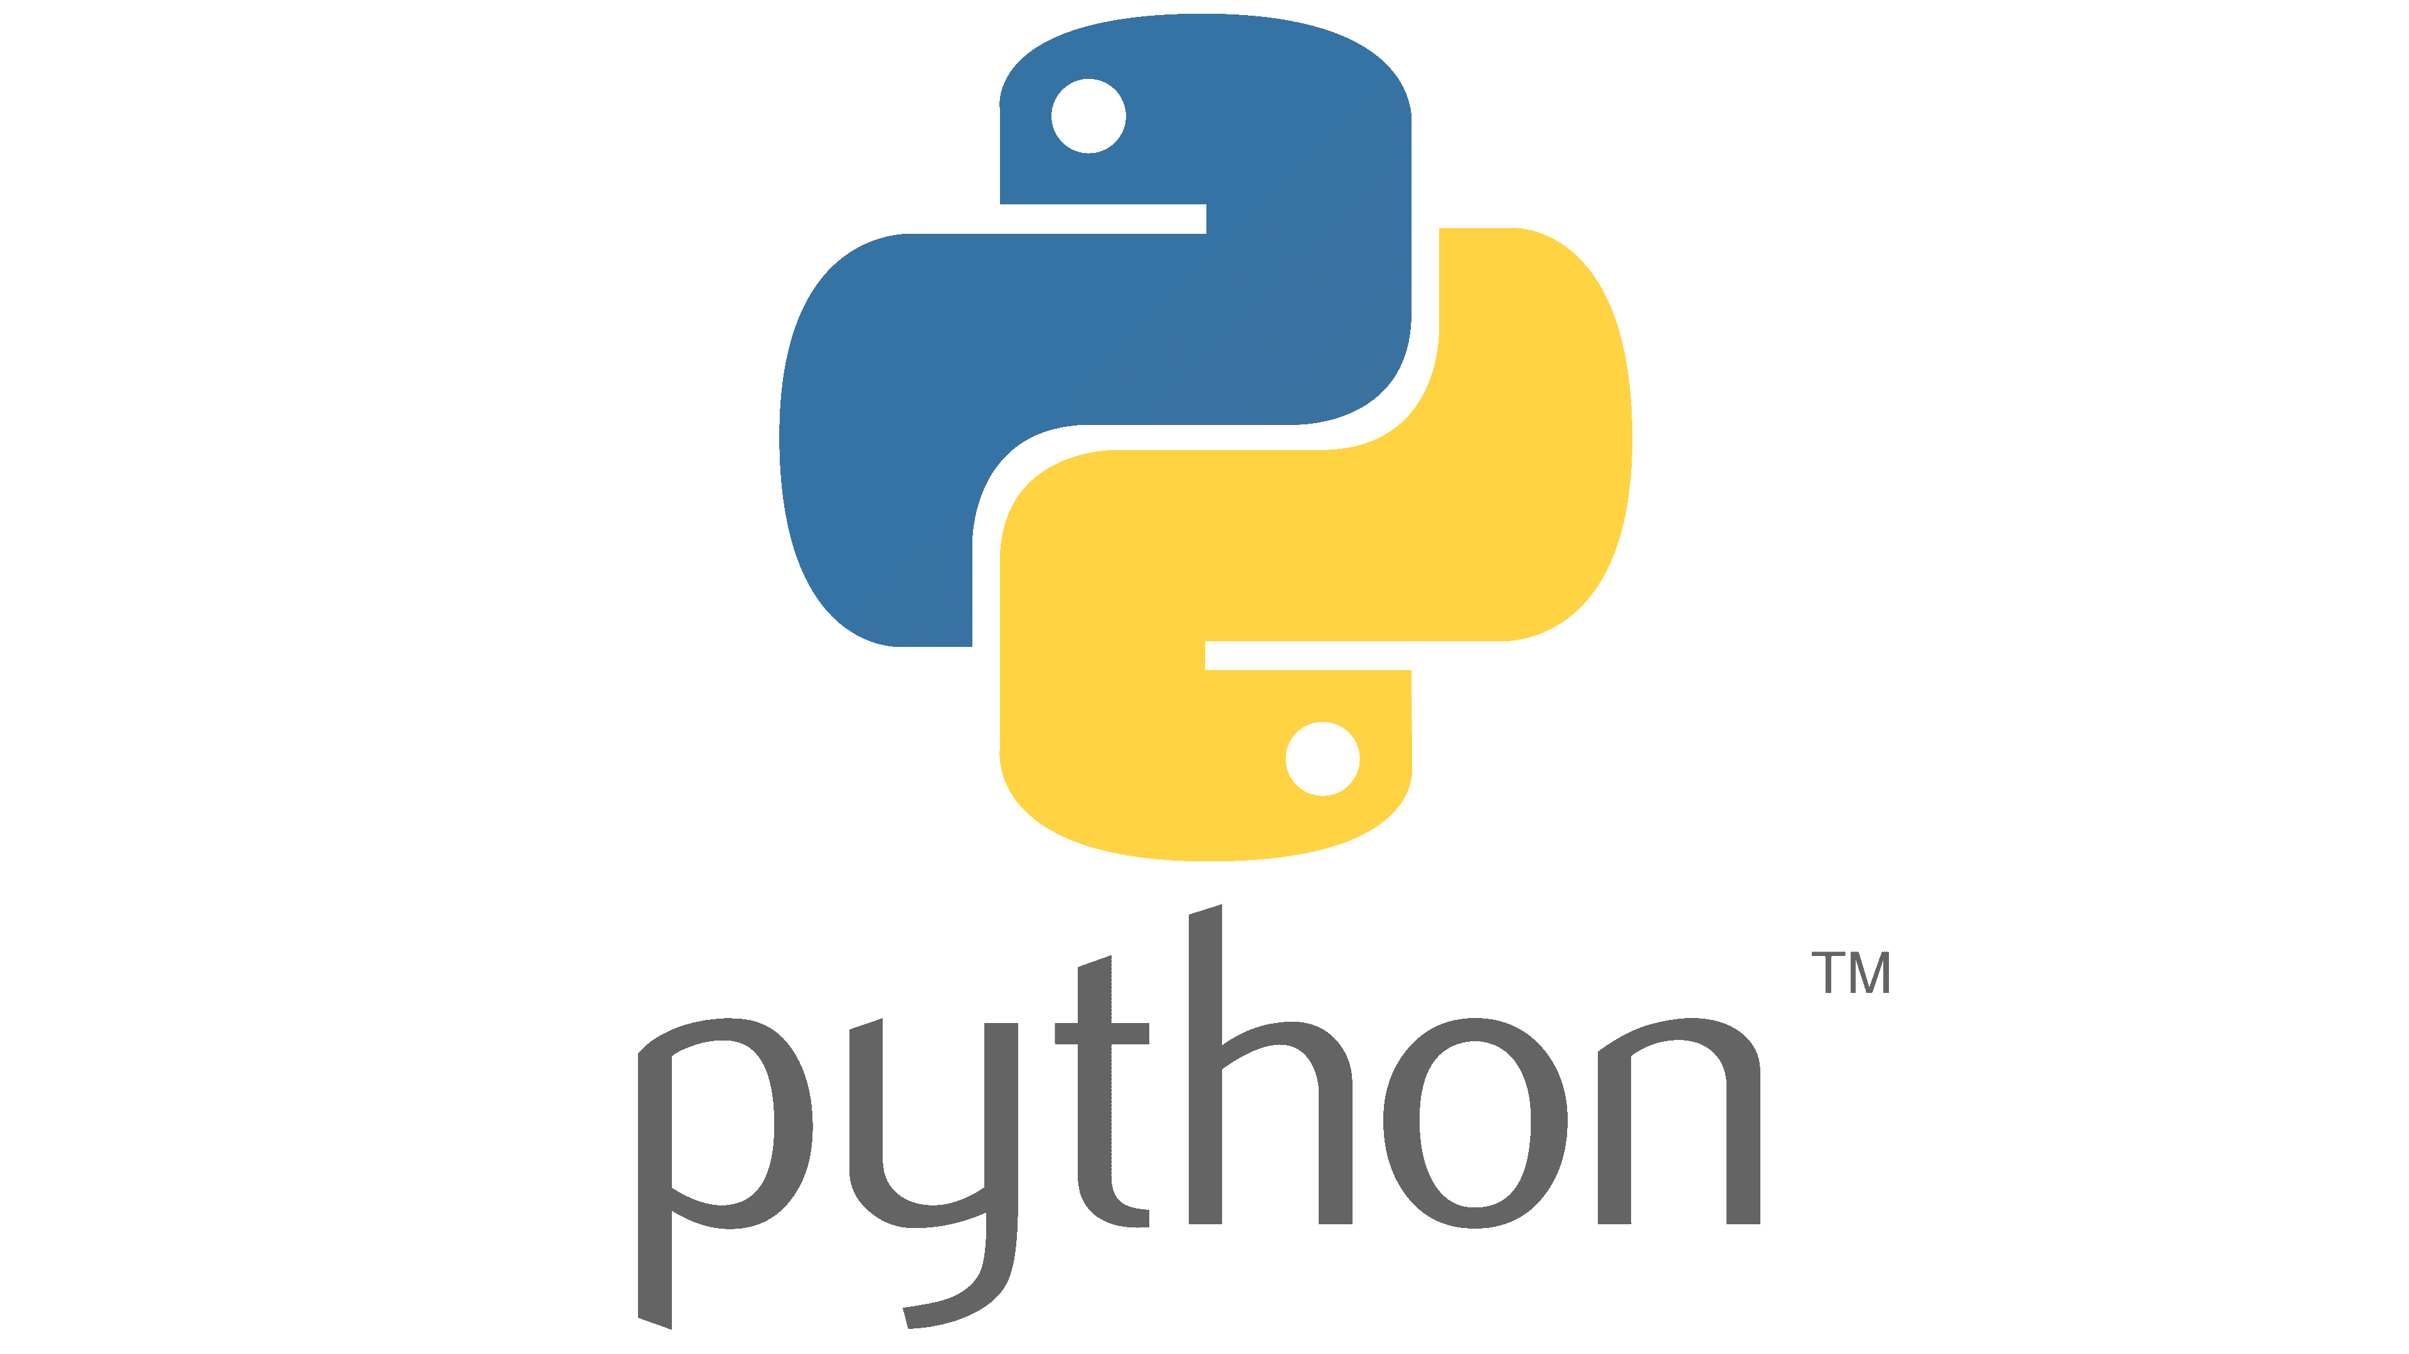

Outline
Creating scripts in Basic
The ScriptForge library
Types of scripts in LibreOffice
Creating Python scripts

Slide 4
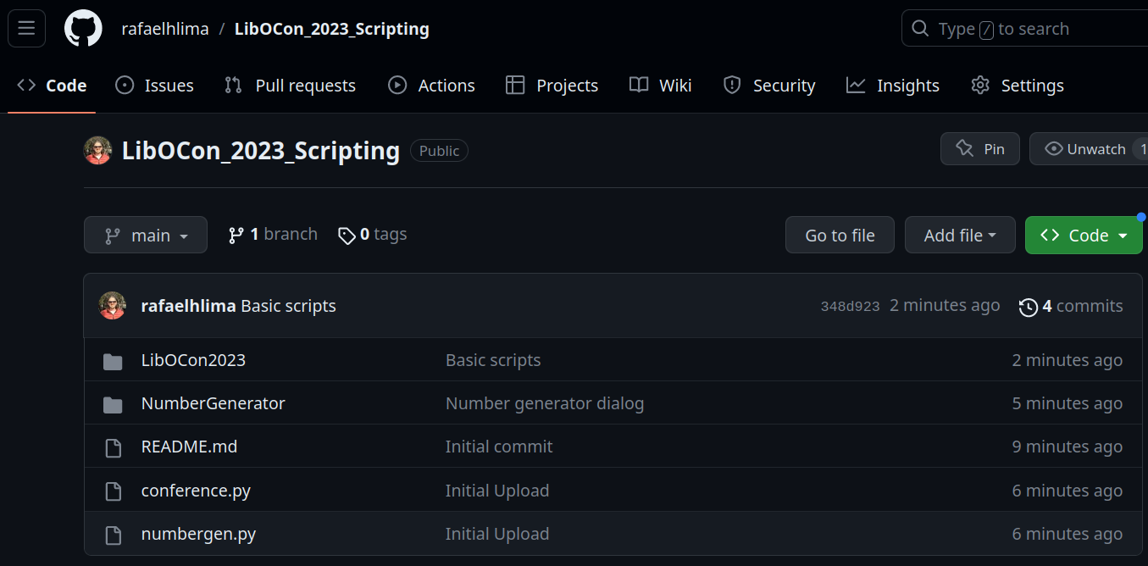

GitHub repository
All examples are available at the following repository
Link: https://github.com/rafaelhlima/LibOCon_2023_Scripting

Slide 5
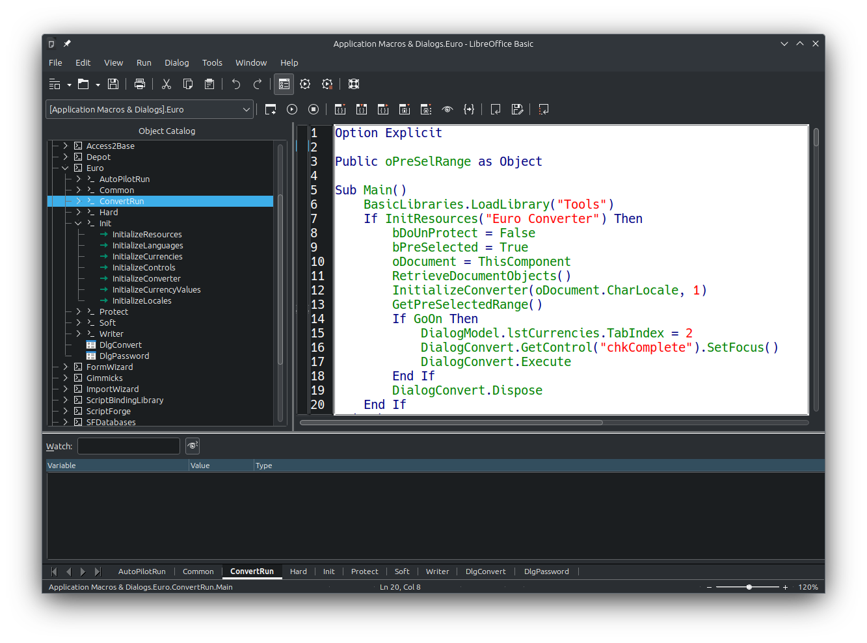
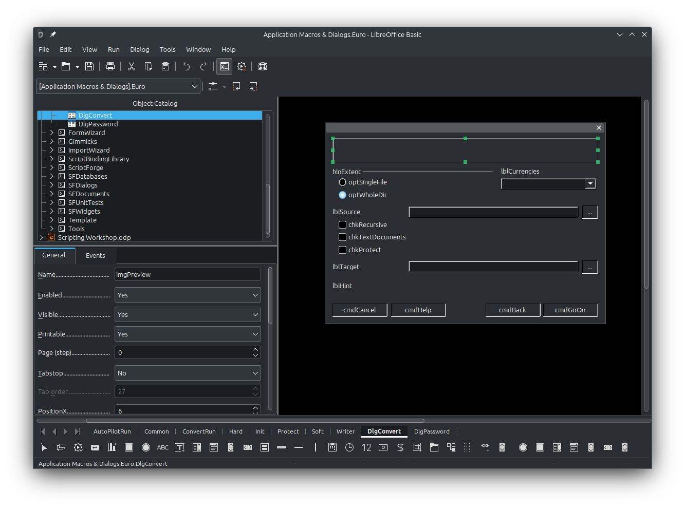

Starting with the Basics
LibreOffice has a built-in IDE for creating scripts with the Basic language
It can also be used to create and edit dialogs

Slide 6
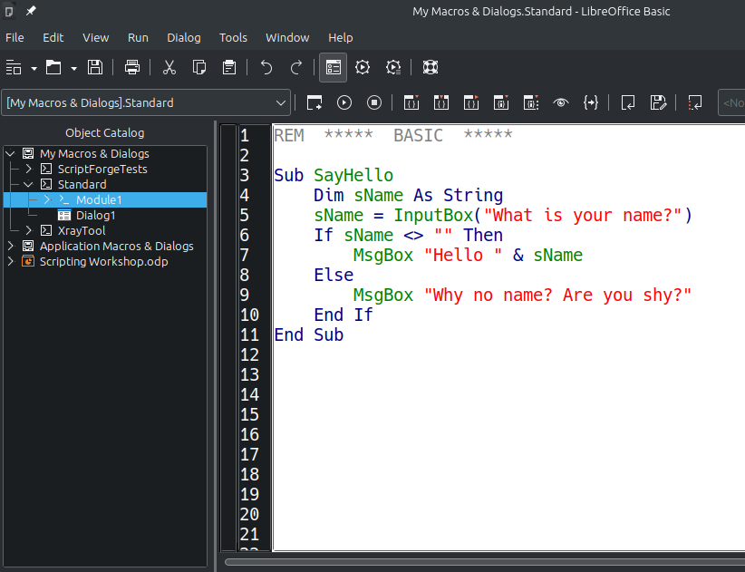
Starting with the Basics
Open any LibreOffice application (f.i. open Calc)
Go to Tools – Macros – Edit Macros
A default module named “Module 1” from the “Standard” library will be selected
Create the sub SayHello by writing the next code
Place the cursor anywhere inside the sub
Click the Run button (or press F5)

Slide 7
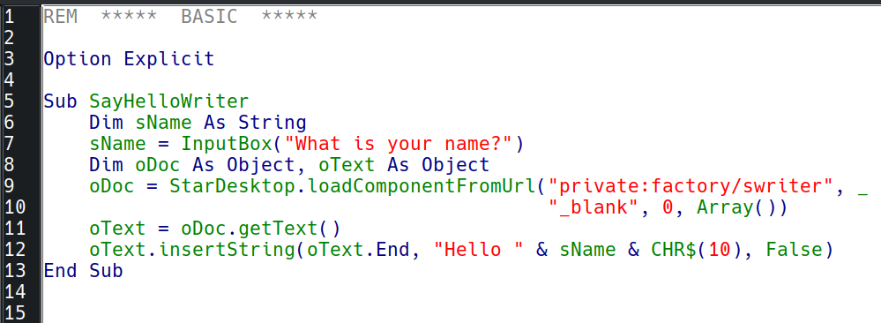
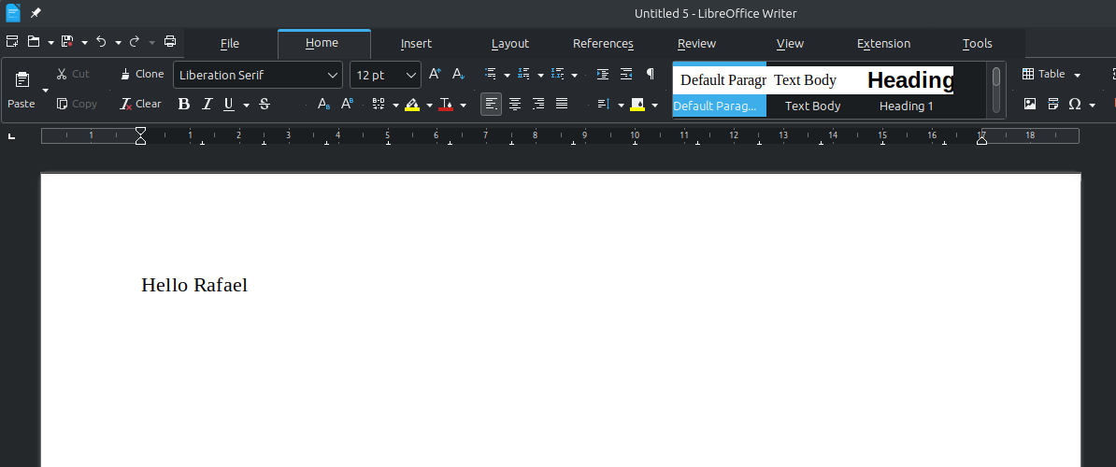
Starting with the Basics
Open any LibreOffice application
Add the following subroutine
This script will create a Writer document with some text in it

Slide 8
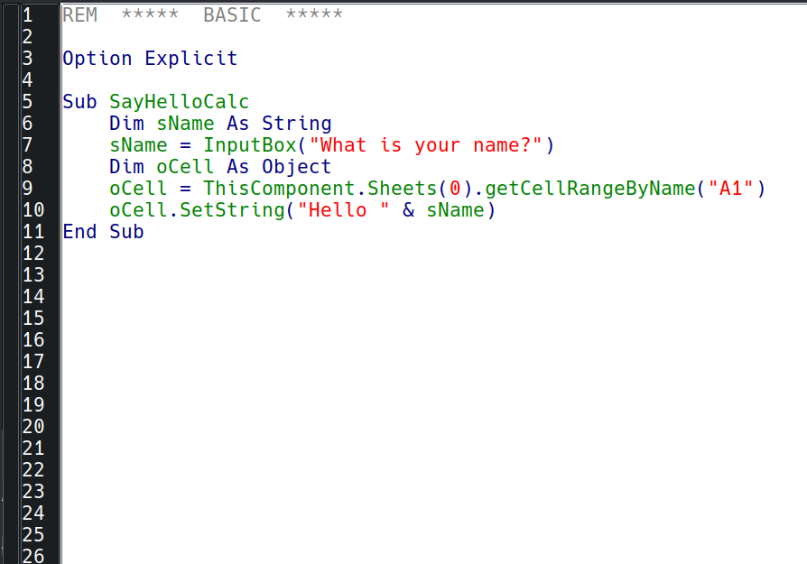
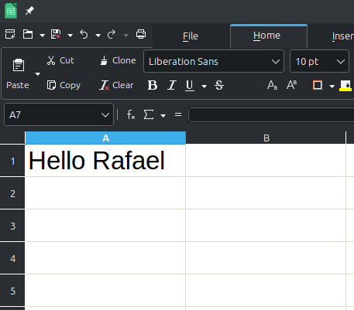
Starting with the Basics
Open LibreOffice Calc
Create the next subroutine and run it
It will write the provided name in cell “A1”

Slide 9
Starting with the Basics
What are StarDesktop and ThisComponent?
StarDesktop
Special variable available in Basic to access the desktop component
ThisComponent
Special variable that provides access to the current document
More info:
https://help.libreoffice.org/latest/en-US/text/sbasic/shared/stardesktop.html
More info:
https://help.libreoffice.org/latest/en-US/text/sbasic/shared/03132200.html

Slide 10
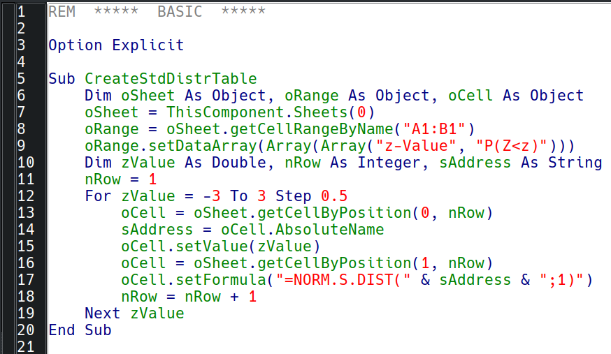
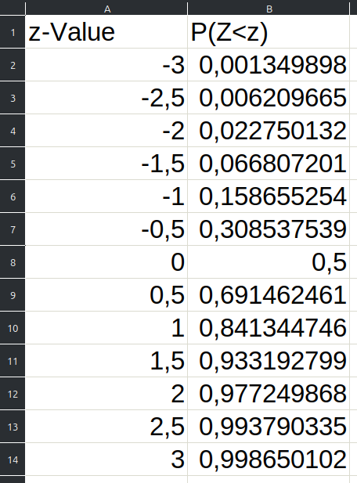
Starting with the Basics
Open LibreOffice Calc
Create the next subroutine and run it
It will simply create a table with Z values (standard normal distribution) and cumulative probabilities

Slide 11
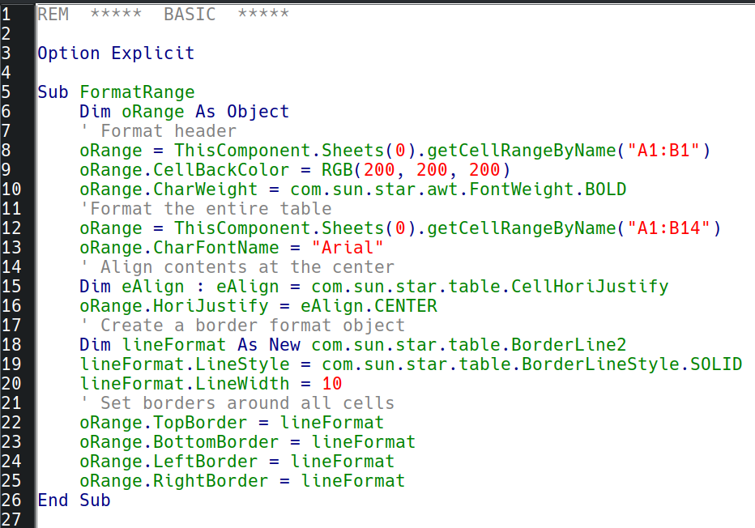
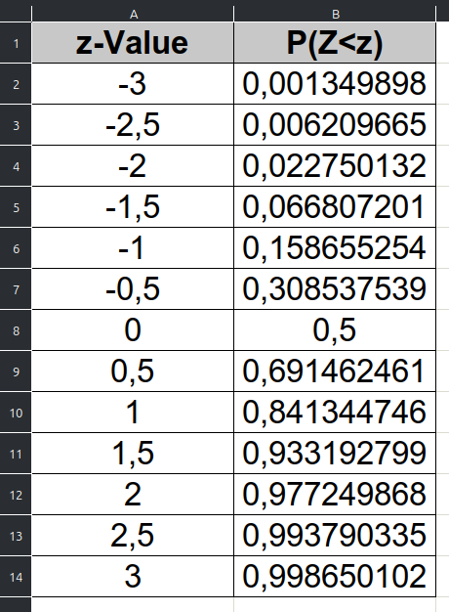
Starting with the Basics
This code formats the table with a header and borders

Slide 12
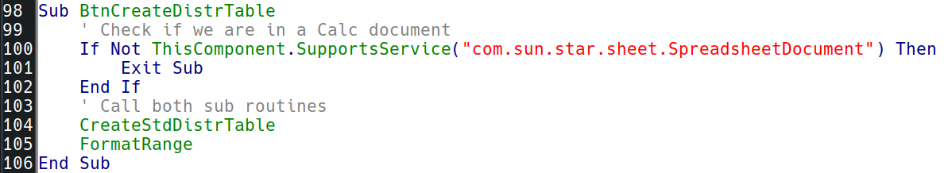

Starting with the Basics
The code below calls both Subs and makes sure they are only executed on Calc documents
Calc | com.sun.star.sheet.SpreadsheetDocument
Draw | com.sun.star.drawing.DrawDocument
Impress | com.sun.star.presentation.PresentationDocument
Writer | com.sun.star.text.TextDocument
Base | com.sun.star.sdb.OfficeDatabaseDocument

Slide 13
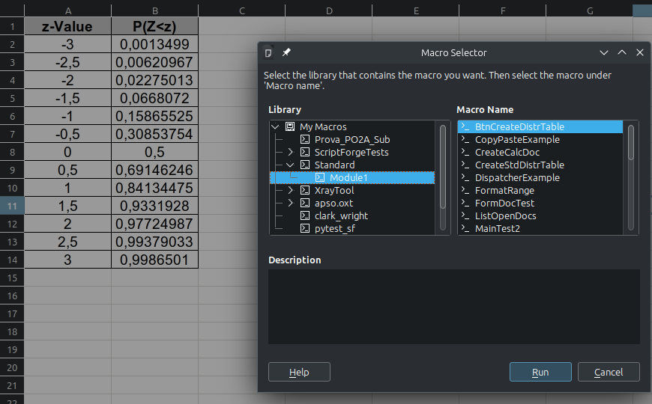
Running Scripts
The easiest way to run a script is to go to Tools – Macros – Run Macro and the use the Macro Selector to choose the desired macro

Slide 14
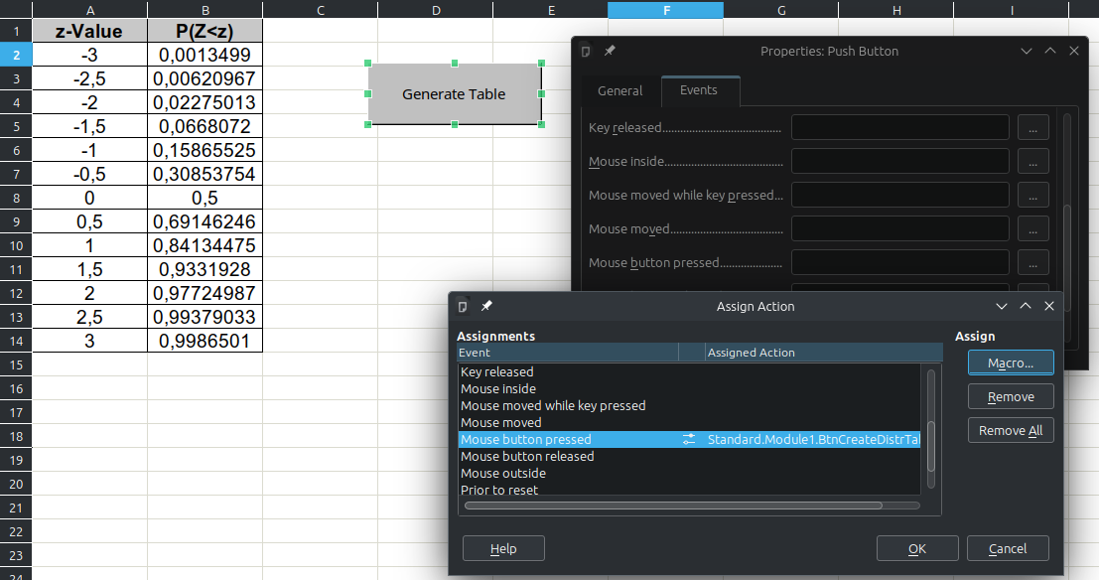
Running Scripts
You can also add controls to the document and associate macros with control events. For instance, create a button and associate it with our macro:

Slide 15
How do I learn all of that?
API references for the previous example
(service) com.sun.star.table.CellRange
https://api.libreoffice.org/docs/idl/ref/servicecom_1_1sun_1_1star_1_1table_1_1CellRange.html
(service) com.sun.star.text.CellRange
https://api.libreoffice.org/docs/idl/ref/servicecom_1_1sun_1_1star_1_1text_1_1CellRange.html
(service) com.sun.star.style.CharacterProperties
https://api.libreoffice.org/docs/idl/ref/servicecom_1_1sun_1_1star_1_1style_1_1CharacterProperties.html
(struct) com.sun.star.table.BorderLine2
https://api.libreoffice.org/docs/idl/ref/structcom_1_1sun_1_1star_1_1table_1_1BorderLine2.html
(constant group) com.sun.star.table.BorderLineStyle
https://api.libreoffice.org/docs/idl/ref/namespacecom_1_1sun_1_1star_1_1table_1_1BorderLineStyle.html
(constant group) com.sun.star.awt.FontWeight
https://api.libreoffice.org/docs/idl/ref/namespacecom_1_1sun_1_1star_1_1awt_1_1FontWeight.html

Slide 16
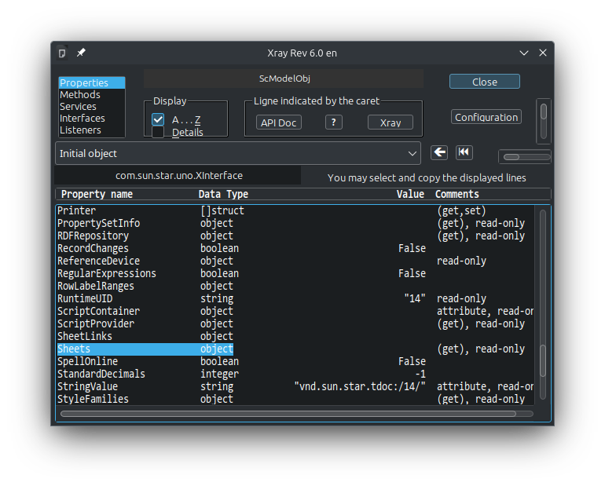
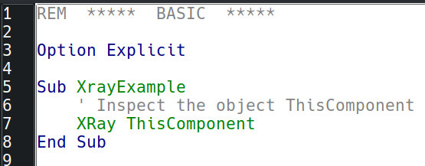
How do I learn all of that?
The learning curve may seem steep at first, but there are tools and learning resources to help smooth it
XRay tool: used to inspect objects and helps to discover their properties and methods
Download link:
https://berma.pagesperso-orange.fr/Files_en/XrayTool60_en.odt

Slide 17
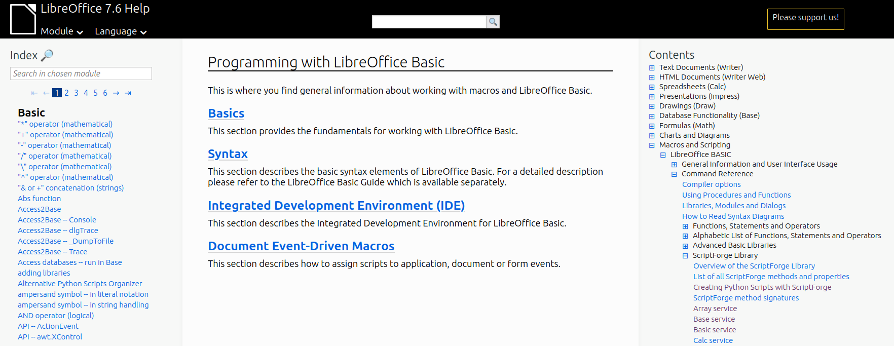
How do I learn all of that?
LibreOffice Basic official help pages
Link: https://help.libreoffice.org/latest/en-US/text/sbasic/shared/01000000.html

Slide 18
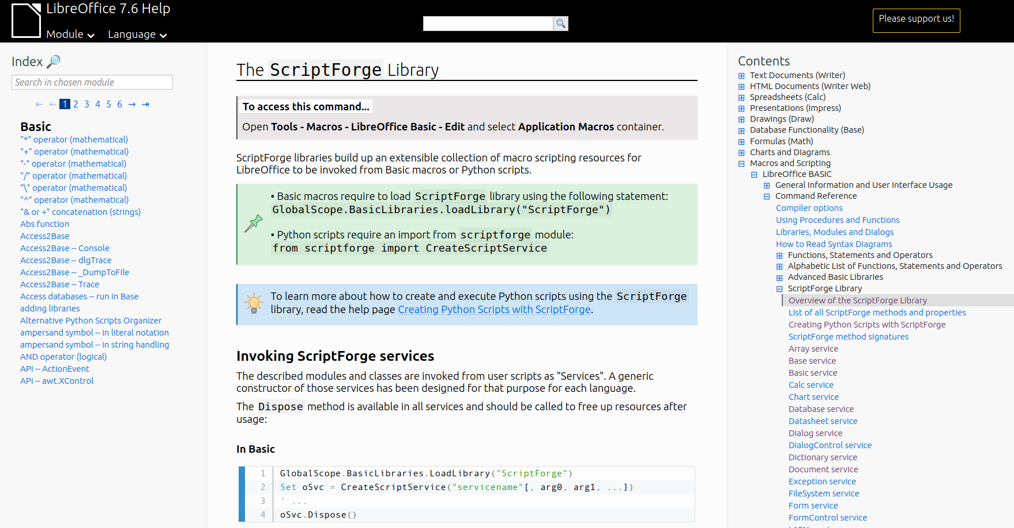
How do I learn all of that?
ScriptForge Library help pages
Link: https://help.libreoffice.org/latest/en-US/text/sbasic/shared/03/lib_ScriptForge.html

Slide 19
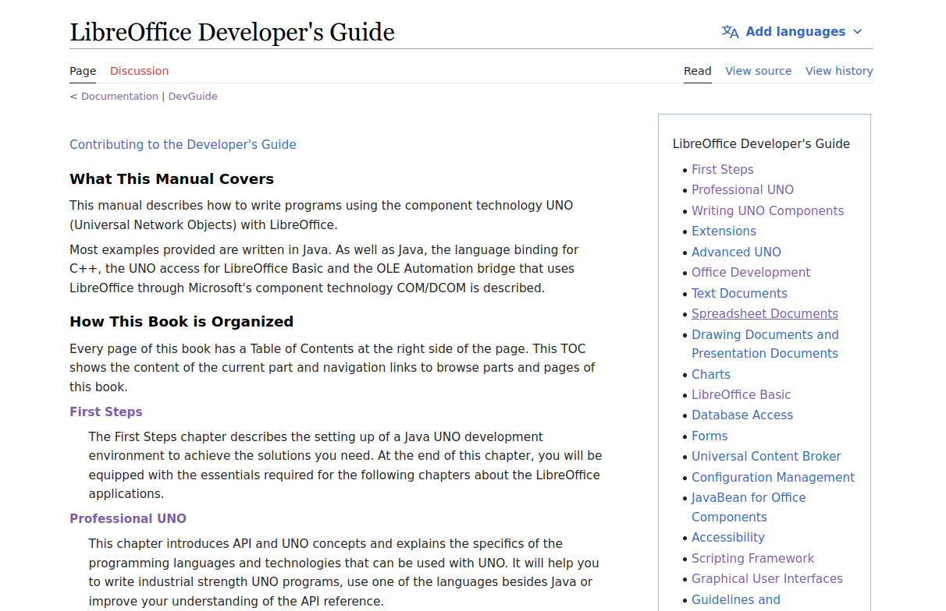
How do I learn all of that?
LibreOffice Developer's Guide
Link: https://wiki.documentfoundation.org/Documentation/DevGuide/LibreOffice_Developers_Guide

Slide 20
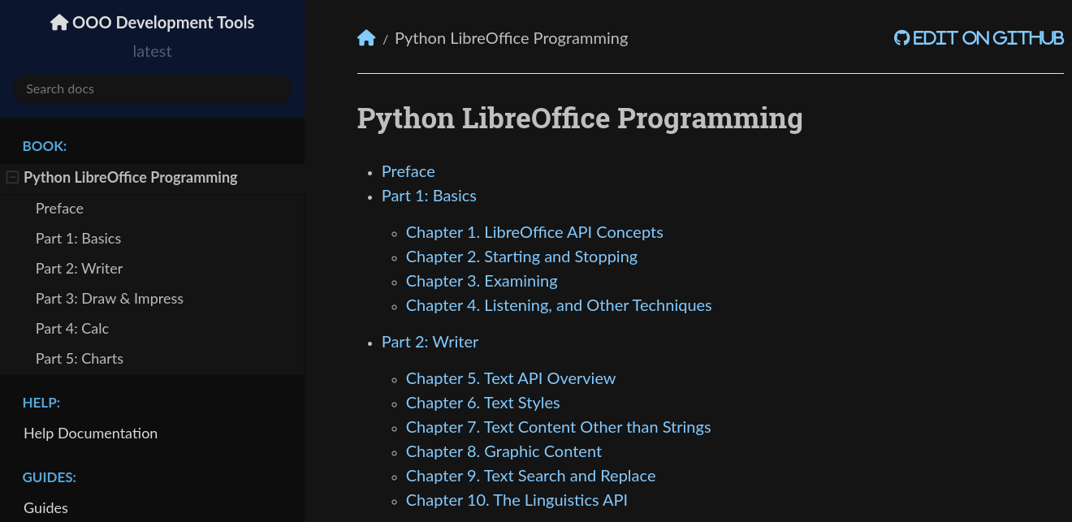
How do I learn all of that?
Python LibreOffice Programming
Link: https://python-ooo-dev-tools.readthedocs.io/en/latest/odev/index.html

Slide 21
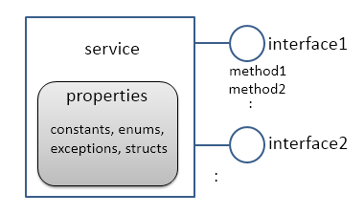
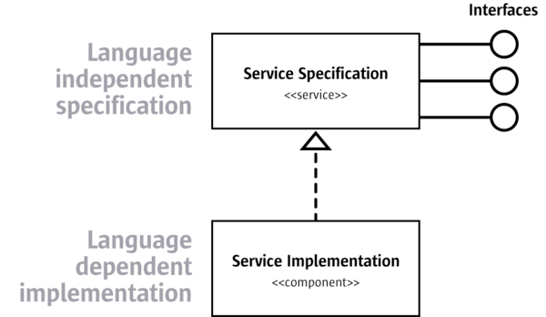
The UNO API
UNO stands for Universal Network Objects and is the base component technology for LibreOffice
It allows to write components using multiple languages (C++, Java, Basic and Python)
The Scripting framework allows to create scripts using Basic, Python, JavaScript and BeanShell
Terminology in the API: interfaces, services, properties, constants and components

Slide 22
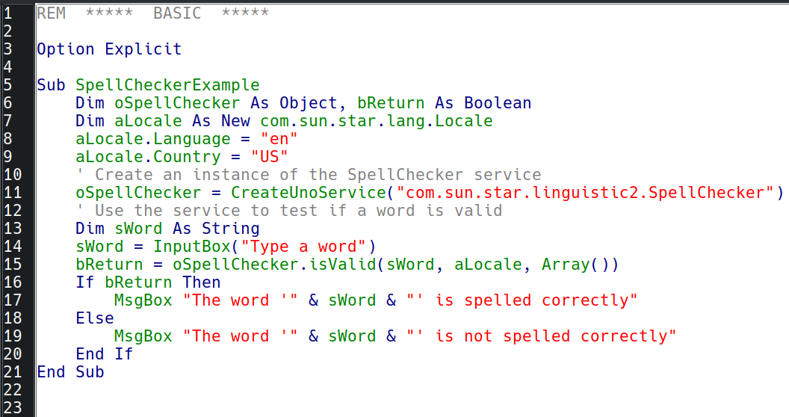
The UNO API
Service Manager
Allows to instantiate UNO services and use them in scripts
Service documentation:
https://api.libreoffice.org/docs/idl/ref/servicecom_1_1sun_1_1star_1_1linguistic2_1_1SpellChecker.html

Slide 23
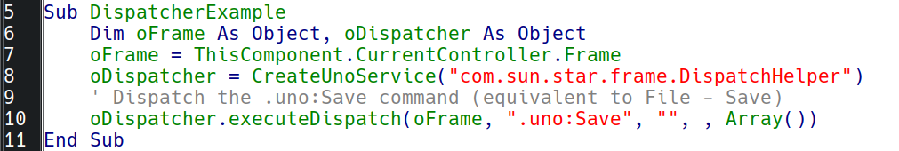
UNO Commands
Command Dispatcher: you can also dispatch UNO commands in your scripts using the DispatchHelper service
There are various commands that can be dispatched, for a full list, see https://wiki.documentfoundation.org/Development/DispatchCommands

Slide 24
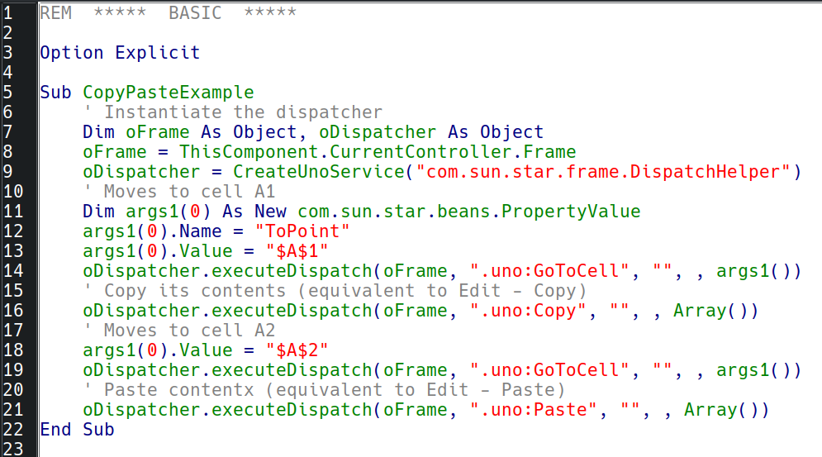

UNO Commands
The next example uses UNO commands to copy cell A1 and paste it into cell A2

Slide 25
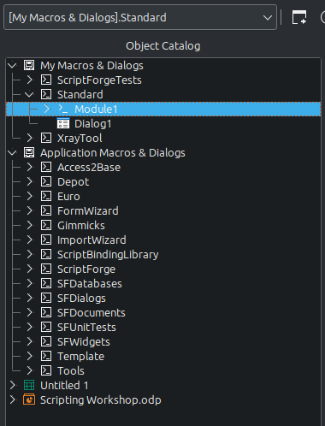
Organizing Scripts
Current library
Containers, libraries, modules and dialogs
Library container
A library may contain multiple modules and dialogs
Library container
A document is also a library container

Slide 26
Organizing Scripts
My Macros & Dialogs: available to all documents for the current user
Application Macros & Dialogs: available to all users and documents (read-only)
Document Macros & Dialogs: used to embed macros in a document
User scripts
Application scripts
Document scripts

Slide 27
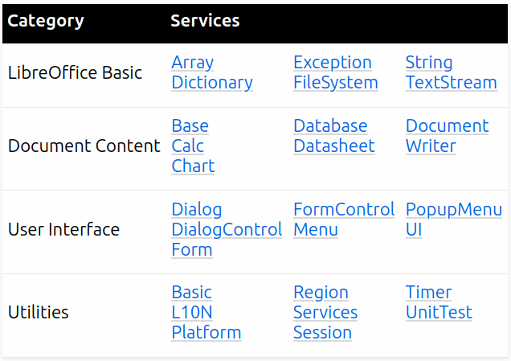
ScriptForge Library
Offers a variety of services and methods to simplify the creation of Basic and Python scripts by hiding the complexity of the UNO API
Extend the Basic API
Access document contents
Access dialogs and dialog controls, as well as UI elements
Utilities to simplify common tasks performed by macros

Slide 28
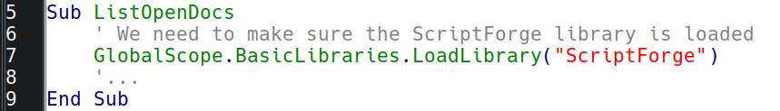
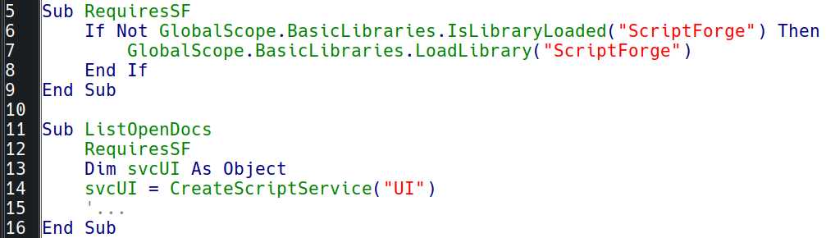
ScriptForge Library
We need to load the ScriptForge library before using it
We can create a library loader do make it easier
We just need to load SF just once in the same session; use this only if you’re unsure SF will have already been loaded

Slide 29
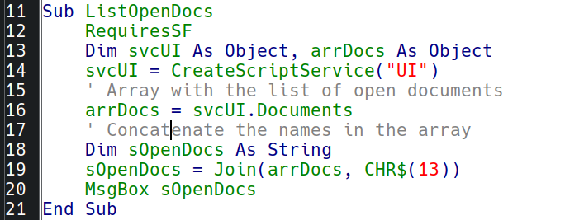
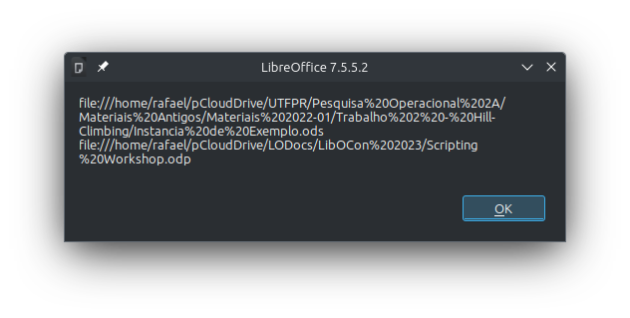
ScriptForge Library
Example: Check all open document windows
The UI service provides access to all open windows
The documents here are shown using URL notation

Slide 30
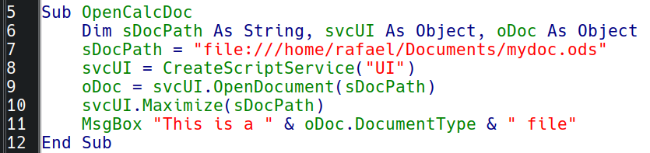
ScriptForge Library
Example: Open an existing Calc document and maximize its window
In this macro “oDoc” is an instance of the “Calc” service

Slide 31
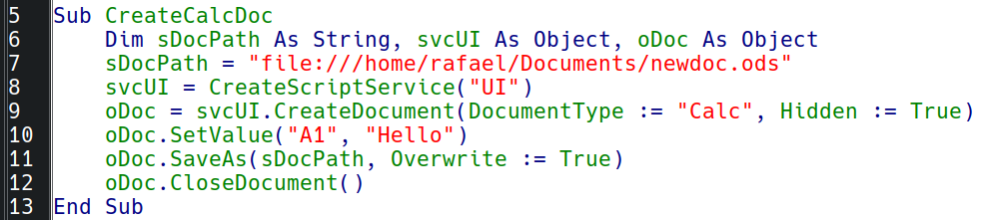
ScriptForge Library
Example: Creates an empty Calc document, adds some content and saves it without showing the window to the user

Slide 32
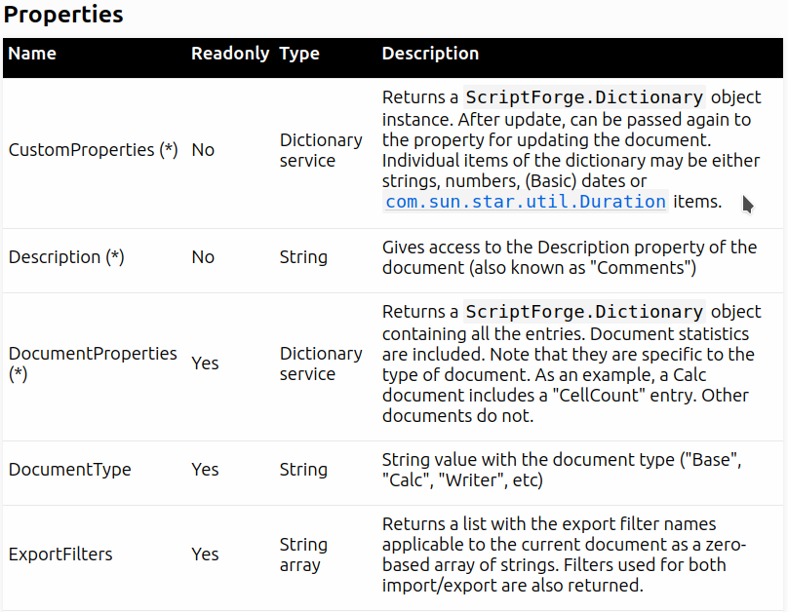
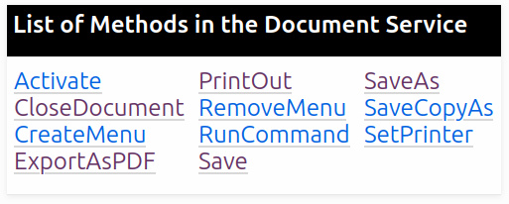
ScriptForge Library
Services are composed of properties and methods (see their documentation in the corresponding help pages); Below is the “Document” service:

Slide 33
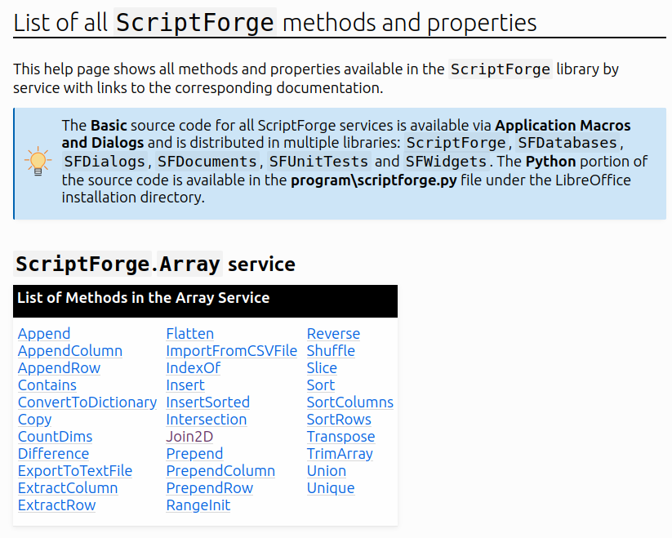
ScriptForge Library
This help page has a list of all properties and methods provided by all ScriptForge services
Link: https://help.libreoffice.org/latest/en-US/text/sbasic/shared/03/sf_toc.html

Slide 34
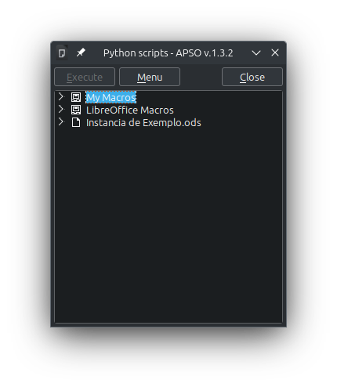
Creating Python Scripts
LibreOffice has supported Python scripts since its first release in 2010
The default LibreOffice installation comes with a bundled Python interpreter
However, LibreOffice does not have an integrated Python IDE (yet ☺)
To make it easier to create and run Python scripts, it is recommended to use the APSO (Alternative Script Organizer for Python) extension
Download link:
https://extensions.libreoffice.org/en/extensions/show/apso-alternative-script-organizer-for-python

Slide 35
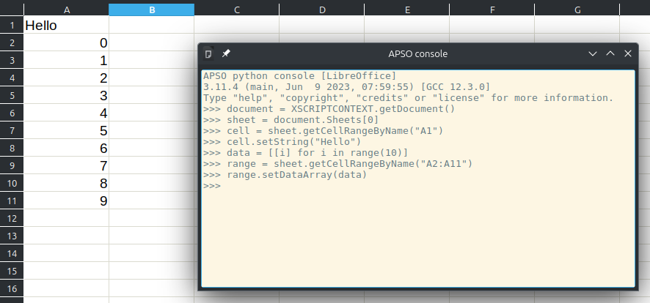
Creating Python Scripts
You can use APSO’s Python console to execute Python commands
XSCRIPTCONTEXT is a global variable that gives access to the Desktop (via getDesktop) and the Document (via getDocument)
XSCRIPTCONTEXT is documented here:
https://help.libreoffice.org/latest/en-US/text/sbasic/python/python_programming.htm

Slide 36
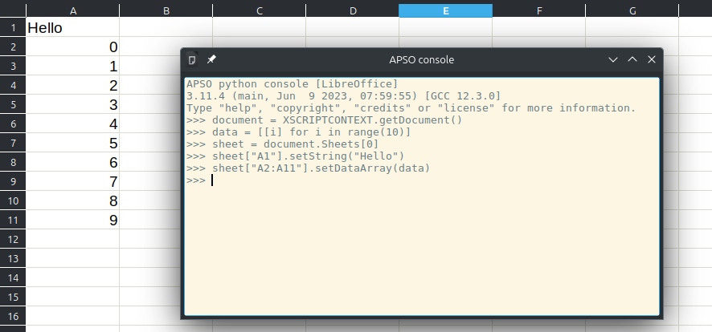
Creating Python Scripts
In Python scripts we can use a more “Pythonic” syntax:

Slide 37
Creating Python Scripts
Where can we create user scripts that can be used across documents?
Application Macros (all users)
  For Windows: {Installation}\share\Scripts\python
  For Linux and macOS: {Installation}/share/Scripts/python
User Macros (current user only)
  For Windows: %APPDATA%\LibreOffice\4\user\Scripts\python
  For Linux and macOS: $HOME/.config/libreoffice/4/user/Scripts/python

Slide 38
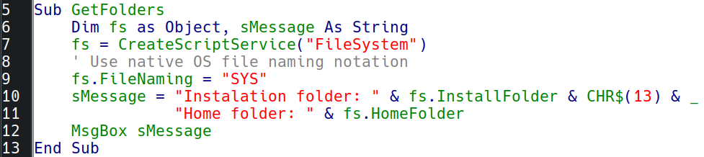
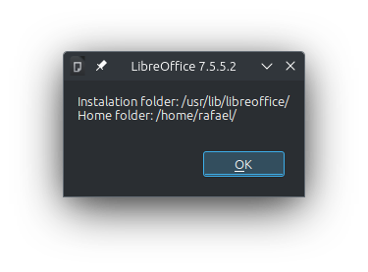
Creating Python Scripts
Run the following Basic script to locate where your installation and home folder are (note that the script uses the FileSystem service from the ScriptForge library):

Slide 39
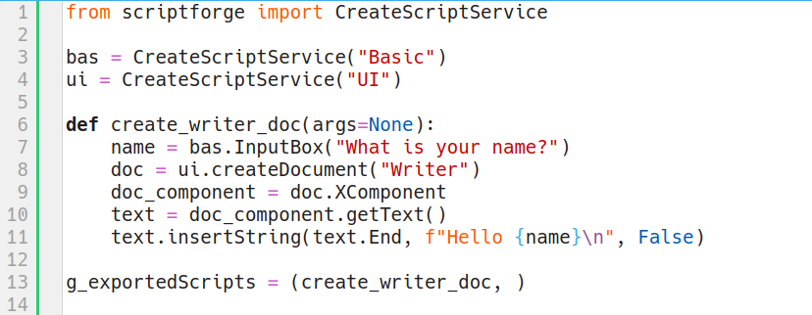
Creating Python Scripts
Let’s convert to Python the script that creates a Writer document with a hello message in it (using ScriptForge)
Tells which scripts will be available via
Tools – Macros – Run Macro dialog

Slide 40
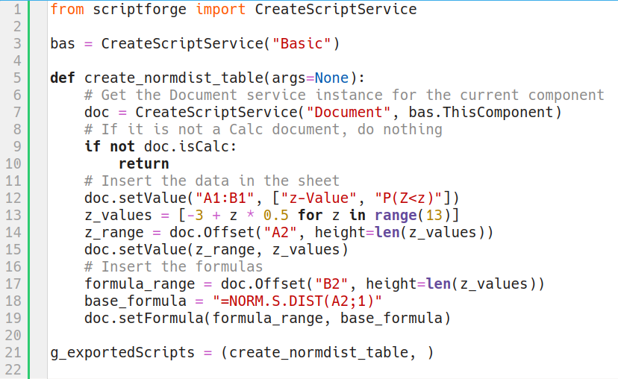
Creating Python Scripts
Now let’s convert the “normal distribution” example using Python and ScriptForge

Slide 41

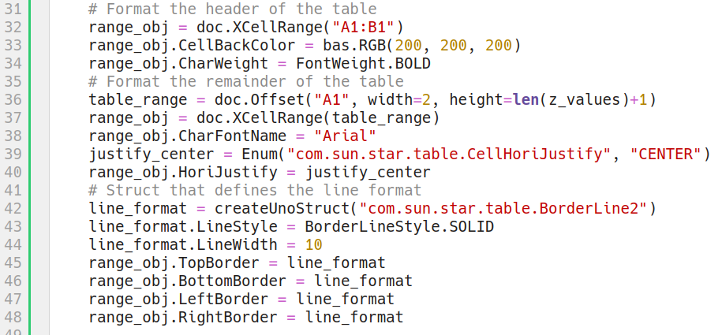
Creating Python Scripts
Now let’s add the table formatting code
Note the new imports of the UNO API
Continuation of create_normdist_table

Slide 42
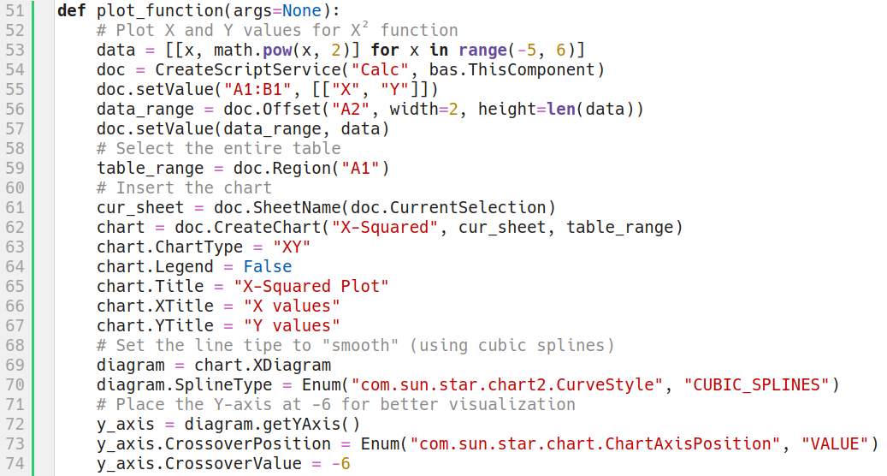
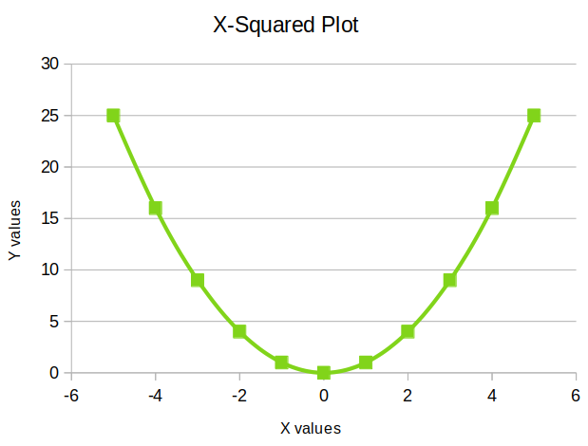
Creating Python Scripts
This example plots a chart of the X-squared function to illustrate charting capabilities
Instance of the “Chart” service

Slide 43
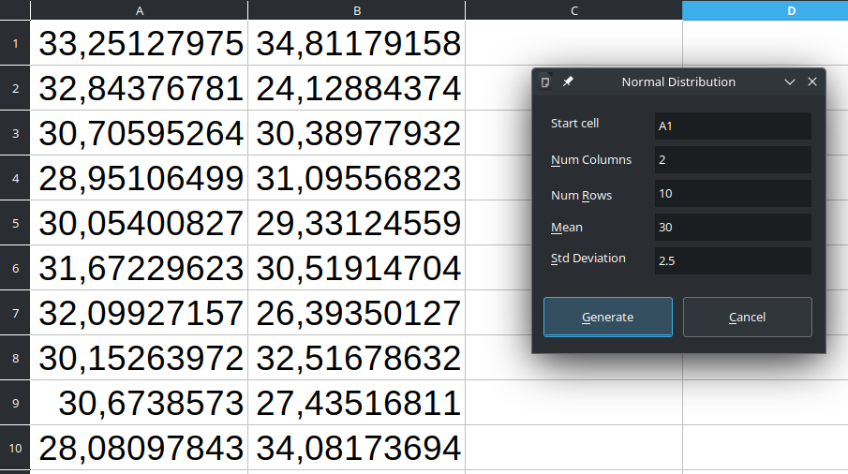
Creating Python Scripts
Now we will create a script that uses a dialog
It will be a simple random number generator that uses the Gaussian implementation in the “random” Python module

Slide 44

Creating Python Scripts
First we need to create the dialog using the Basic IDE
The dialog name is NumberGenDlg
Let’s create it in a new library called NumberGenerator
Names
editStartCell
editNumColumns
editNumRows
editMean
editStdDev
Names
btnGenerate
btnCancel

Slide 45

Creating Python Scripts
Now let’s create a Python file numbergen.py with the macros that open the dialog and close it when “Cancel” is pressed

Slide 46

Creating Python Scripts
This macro needs to be associated with the “Generate” button

Slide 47


Thank you …
The ScriptForge team
    Jean-Pierre Ledure, Rafael Lima, Alain Romedenne
Documentation
    https://help.libreoffice.org/latest/en-US/text/
    sbasic/shared/03/lib_ScriptForge.html
ScriptForge Sources
    https://gitlab.com/LibreOfficiant/scriptforge
Type Support (typings) for ScriptForge, by PauL Moss.
    https://github.com/Amourspirit/python-types-scriptforge
Telegram groups
    ScriptForge
    LibreOffice Macros & Scripting

